Slide 1



Investigating the Effect of Socioeconomic Factors on Transmission Dynamic of COVID-19 : A Tweeter-based Surveillance Data Incubator's Data Science Fellowship - Feb 2021 Behnaz Jafari MSc Biostatistics

Slide 2

Background and Justification
Lack of quantitative evidence
Social media interaction has increased
Having the tweets data help us to understand the relationship
It helps policy makers and health care organizations

Slide 3
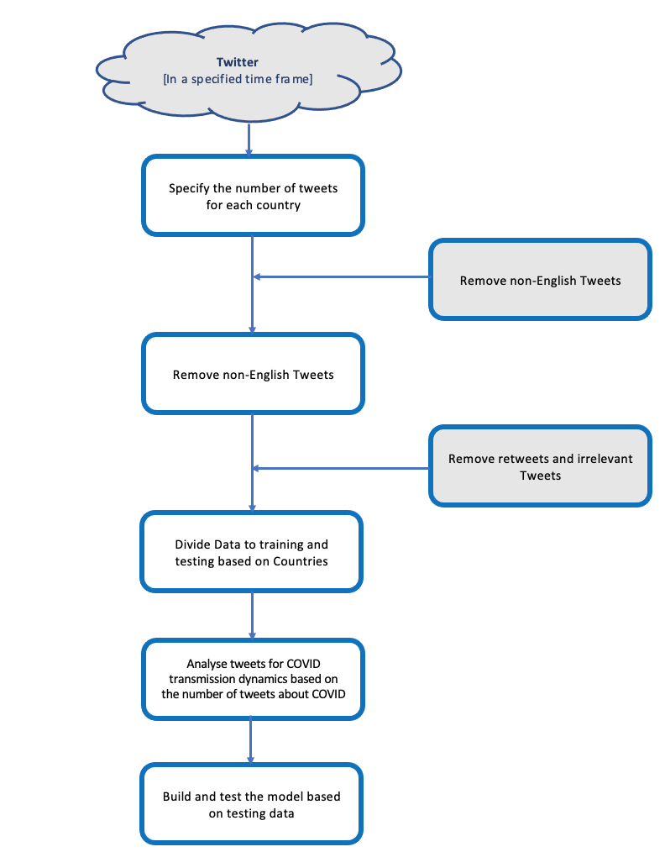
Method

Slide 4

Thank you
Questions?

